Slide 1
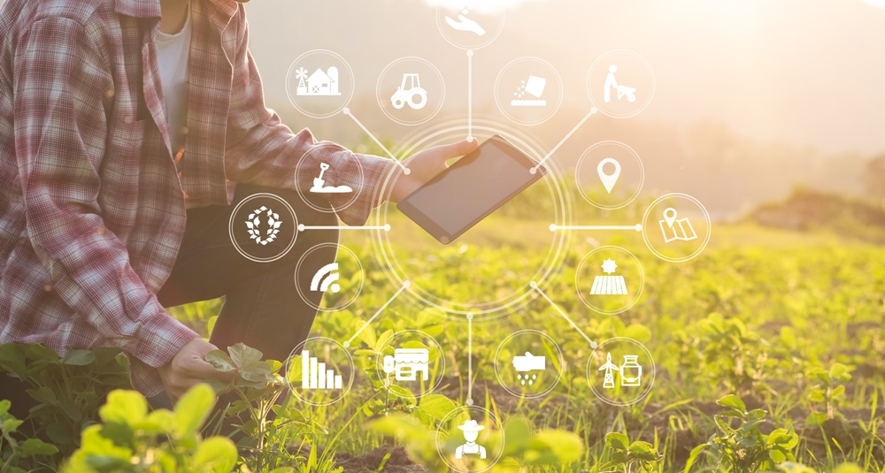
SMART AGRICULTURE SYSTEM BASED ON IoT
By GAVARA GIRIDHAR

Slide 2
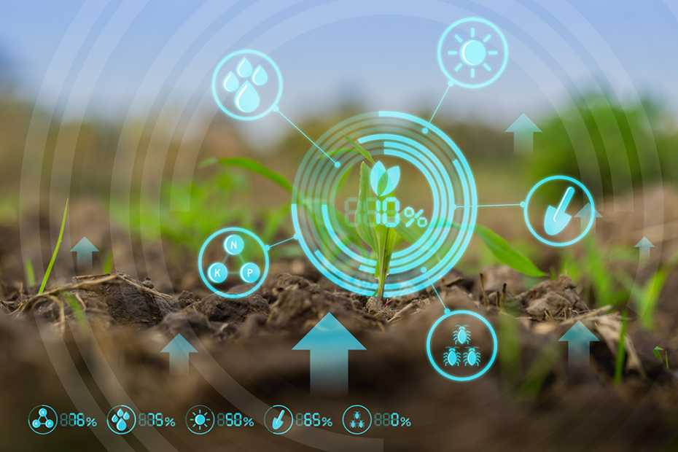
What is Smart Agriculture System?
Smart Agriculture or Smart Farming is a farming management concept using modern technology to increase the quantity and quality of agricultural products.

Slide 3
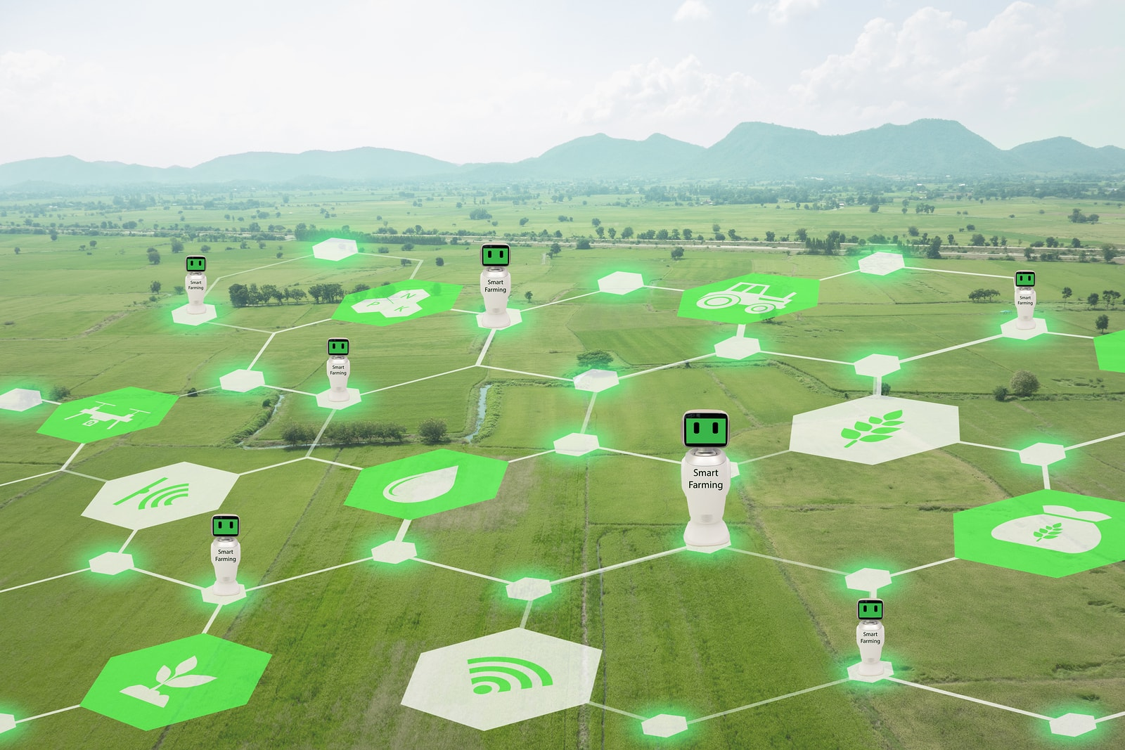
Advantages of Smart Farming
Water Conservation.
Real-Time Data and Production Insight.
Lowered Operation Costs.
Increased Quality of Production.
Accurate Farm and Field Evaluation.
Improved Livestock Farming.
Remote Monitoring.
Equipment Monitoring

Slide 4
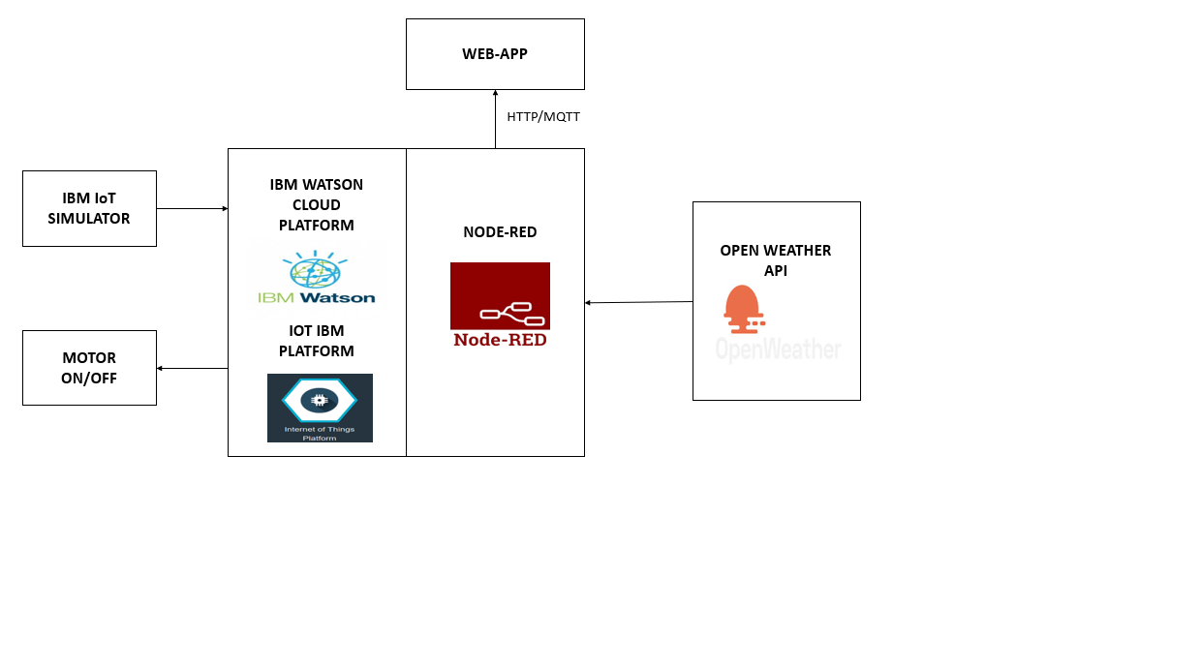
BLOCK DIAGRAM

Slide 5
CONCLUSION
The IoT agricultural applications are making it possible for ranchers and farmers to collect meaningful data. Large landowners and small farmers must understand the potential of IoT market for agriculture by installing smart technologies to increase competitiveness and sustainability in their productions. With the population growing rapidly, the demand can be successfully met if the ranchers, as well as small farmers, implement agricultural IoT solutions in a prosperous manner.

